Slide 1

Project Title: Enhancing Arrhythmia Diagnosis Through ECG Deep Learning Classification Deploying And Augmented Reality 3D Heart Visualization And Interaction

Slide 2
Under the Guidance of : K. Keerthi Reddy
Done by :
K. Pranathi(22U11A6724)
G. Hyndhavi(22U11A6716)
D. Yakub(22U11A6712)
M. Hari Venu(22U11A6721)

Slide 3
CONTENTS
Abstract
Literature survey
Existing system
Proposed system
Module design
UML diagrams

Slide 4
Abstract
The abstract for the ArythmiAR system proposes a critical advancement in diagnosing cardiovascular diseases (CVDs) by addressing the limitations of manual ECG interpretation, which is complex and time-consuming. The novel system integrates Convolutional Neural Networks (CNN) with Augmented Reality (AR) to offer an interactive diagnostic experience featuring 3D visualization and real-time engagement. ArythmiAR's key features include deep learning for precise arrhythmia detection, 3D heart modeling. The research demonstrated highly competitive results on the PhysioNet MIT-BIH Arrhythmia dataset, with the Multilayer Perceptron (MLP) model achieving an accuracy of 99.07% after employing data rebalancing strategies. Ultimately, the AR prototype allows users to visualize and interact with specific heart regions, thereby empowering medical professionals to make more accurate diagnoses and develop effective strategies, thereby improving patient care.

Slide 5
Literature survey
Survey-1:
Paper Title: Prediction of ECG signals from ballistocardiography using deep learning for the unconstrained measurement of heartbeat intervals
published year: 2025
Author: Seiichi Morokuma
Summary:
The paper uses deep learning to convert BCG signals into ECG-like signals, allowing heartbeats to be measured without attaching electrodes to the body.
The method showed high accuracy in predicting heartbeat intervals, even during long-term overnight monitoring, proving it can support comfortable and continuous heart-rate tracking.

Slide 6
Survey-2:
Paper Title: pACPs-DNN: Predicting anticancer peptides using novel peptide transformation into evolutionary and structure matrix-based images with self-attention deep learningmodel
Published year : 2025
Author: Ali Raza, Shahid
Summary:
The paper converts peptide sequences into image-like representations using evolutionary and structural features, then uses a self-attention deep learning model to analyze them.
The model shows very high accuracy in identifying anticancer peptides, outperforming previous methods.

Slide 7
Survey-3:
Paper Title: Automated ECG Arrhythmia Detection Using Deep Convolutional Neural Networks
Authors: Z. Zhao, Y. Zhang, Y. Deng, and X. Zhang
Year: 2023
Summary :
Proposed a deep CNN-based model to automatically classify different types of arrhythmias from ECG signals.
The system was evaluated using the MIT-BIH Arrhythmia dataset and achieved high classification accuracy.
The study showed that deep learning significantly improves ECG analysis and reduces dependency on manual diagnosis.

Slide 8
Existing system
Typically relies on cardiologists manually interpreting ECG signals or using more conventional machine learning (ML) techniques.
Manual interpretation is time-consuming and demands a trained specialist leading to delayed diagnosis.
Previous machine learning models did not scale well to larger, imbalanced datasets, carrying a risk of overfitting. Models often do not generalize well due to differences in how ECGs work across patient populations.
Most systems only offered 2D images of ECG signals or numerical predictions. The 2D ECG plot is not spatially correlated with the area of the heart that is affected (Dimensionality reduces this correlation).

Slide 9
Proposed system
Utilizes Augmented Reality (AR) along with Convolutional Neural Networks (CNN) to provide an interactive, accurate, and immersive experience. CNN and Multilayer Perceptron (MLP) models exhibit highly efficient classification.
Uses data rebalancing methods to classify with improved accuracy on imbalanced datasets.
An AR framework augmented with a 3D model of the human heart allows medical professionals to virtually visualize classifications and localize them in terms of anatomical sub-regions of the heart. 3D heart modelling allows better scrutiny of the cardiac regions.
Automated classification reduces time and dependence on human interpretation of ECGs. The system provides more timely and accurate diagnosis.
Applications: Interactive 3D Visualization - It allows clinicians to visualize and interact with a realistic 3D model of the human heart where arrhythmia anomalies are precisely localized. This helps in better scrutiny of the cardiac regions.

Slide 10
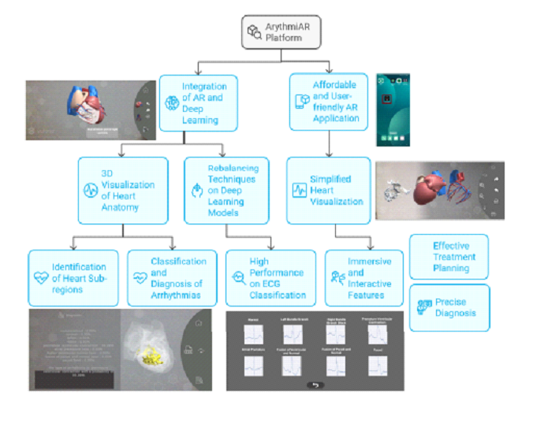
System Architecture

Slide 11
Modules
Data Acquisition & Preprocessing: Collects ECG data and applies noise filtering, normalization, and data rebalancing. Prepares clean, balanced data for training.
Feature Extraction & Classification: Runs CNN/MLP models to automatically detect and classify arrhythmia types. Highly accurate, automated diagnosis (99.07\% accuracy).
3D Heart Modelling: Creates a realistic 3D heart model and maps ECG findings to specific anatomical regions. Allows better scrutiny and spatial correlation of cardiac regions.
Augmented Reality (AR) Integration: Displays the ECG classification and 3D heart model within an AR environment. Allows real-time visualization and interaction with anomalies.
Visualization & Interaction: Facilitates real-time visualization, 3D simulation, and user interaction with localized anomalies. Supports clinical decision-making and patient education.
Decision Support & Evaluation: Evaluates performance metrics(accuracy, f1-score) and provides interpretability

Slide 12
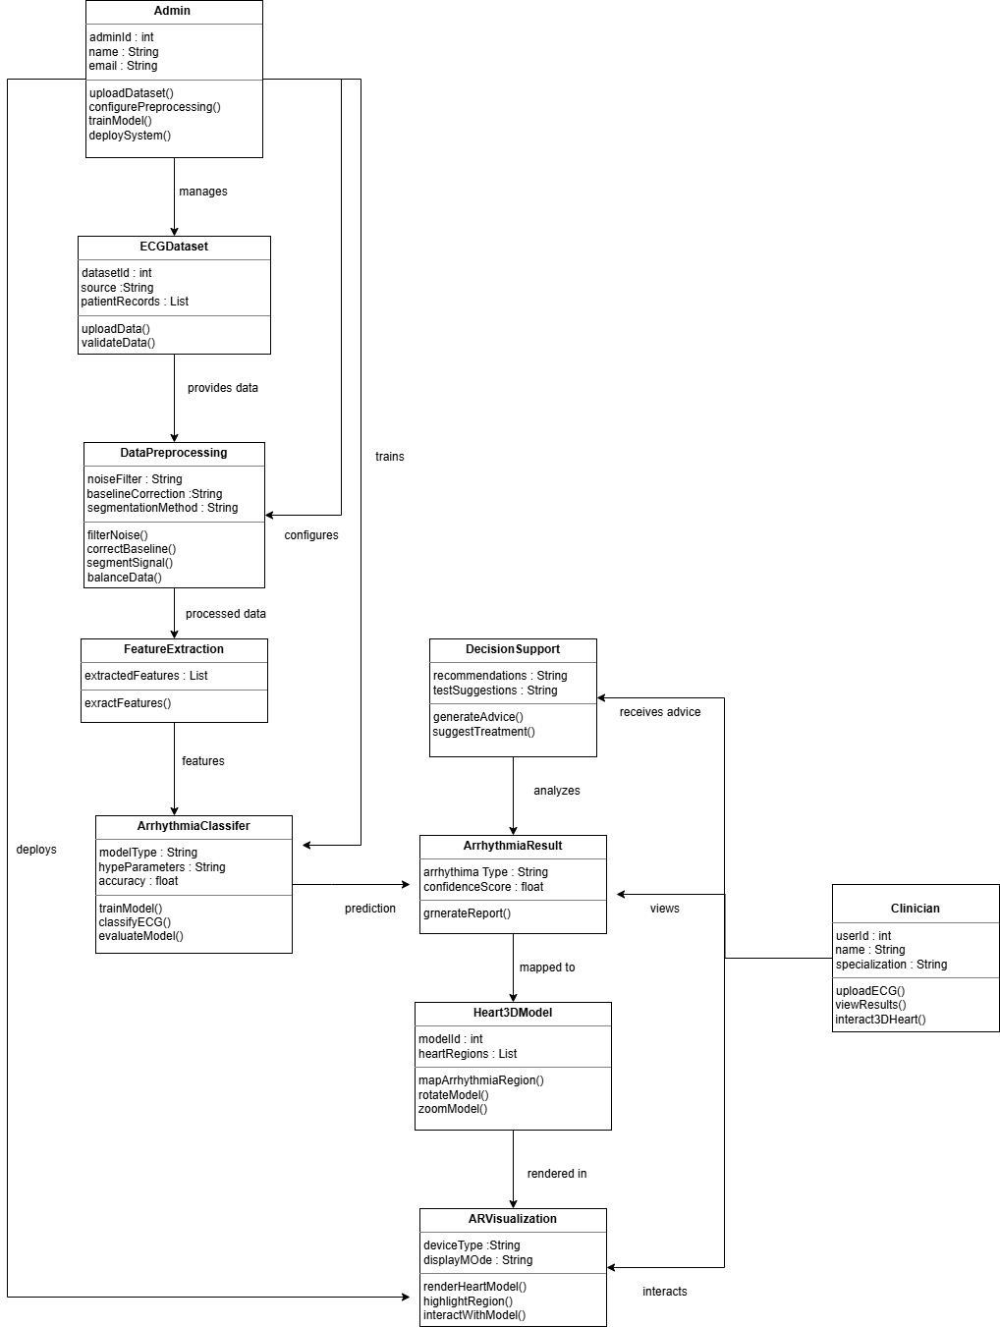
UML diagrams
1. Class Diagram

Slide 13
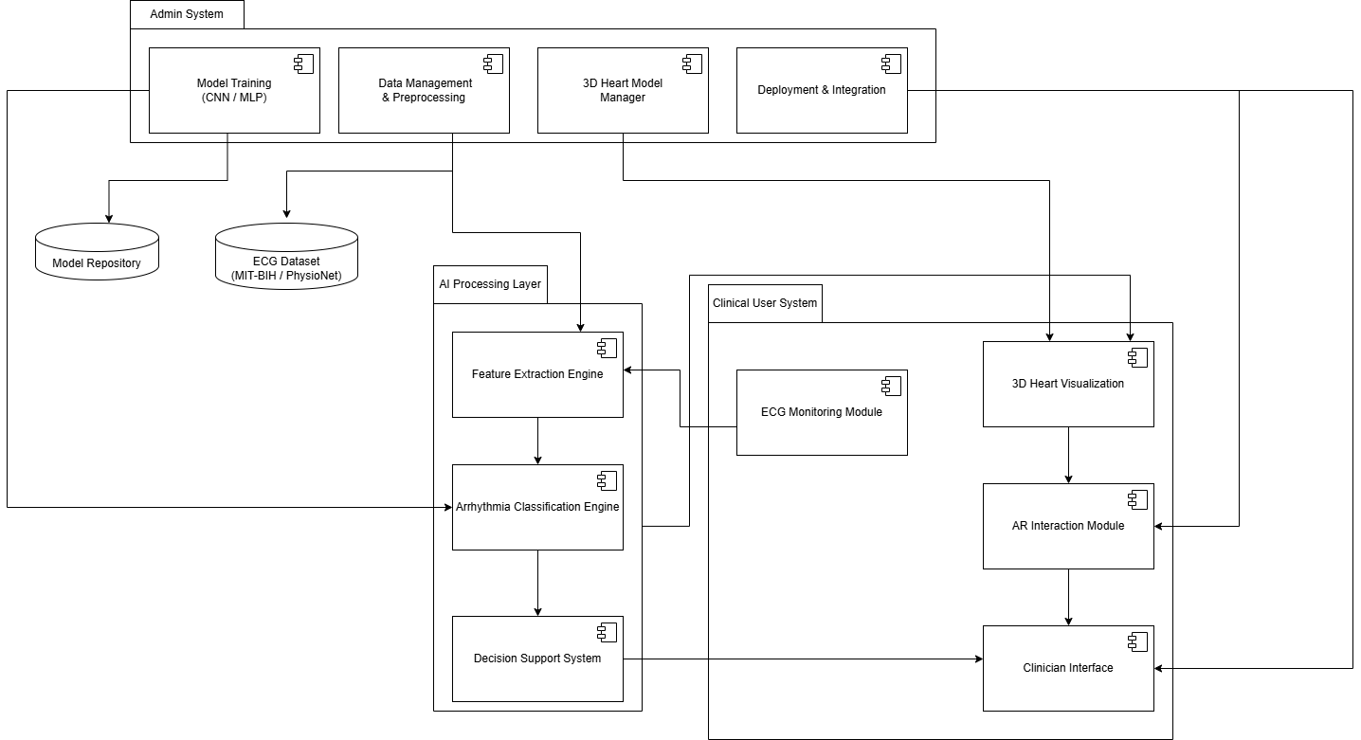
2. Component Diagram

Slide 14
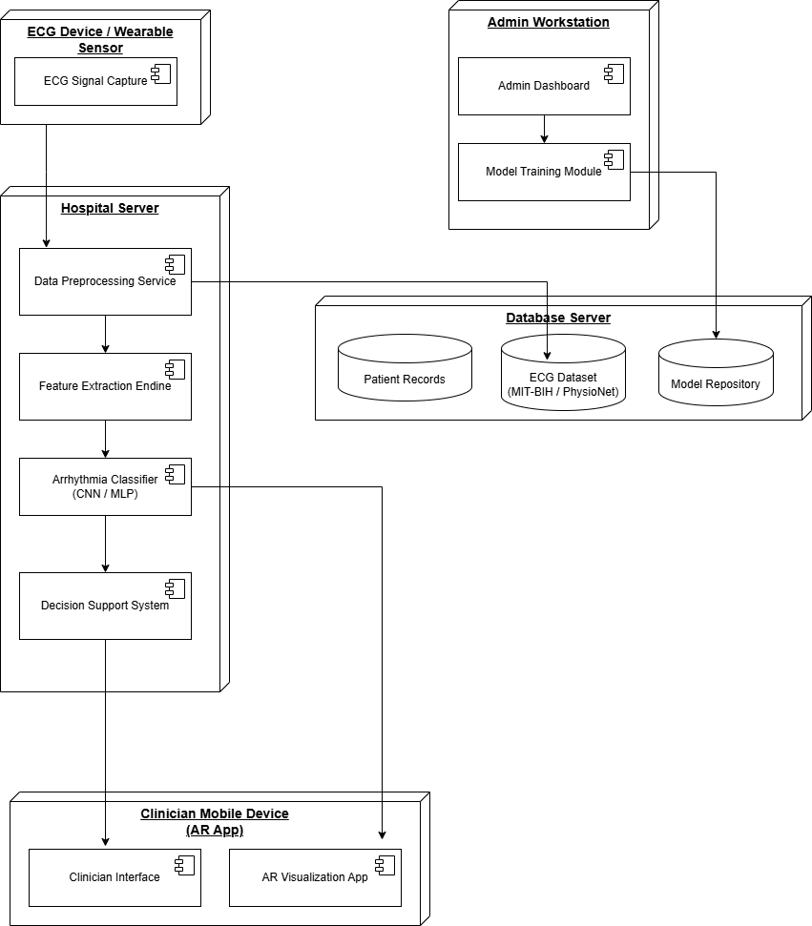
3. Deployment Diagram

Slide 15
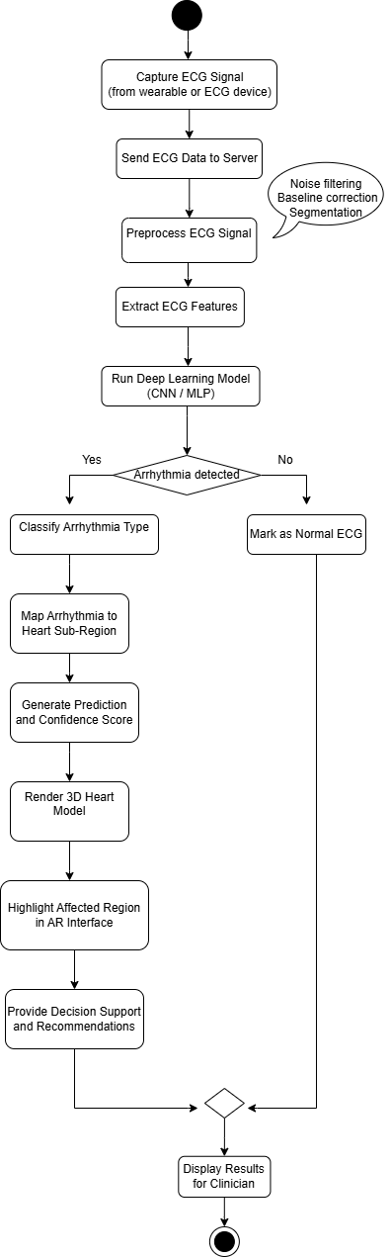
4. Activity Diagram

Slide 16
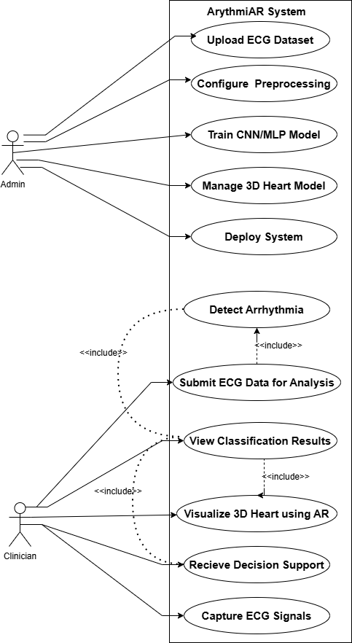
5. Use Case Diagram

Slide 17
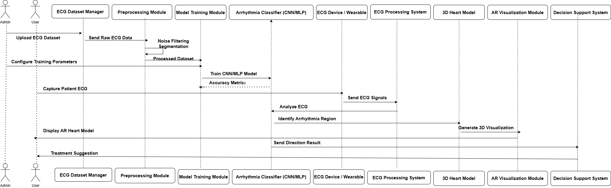
6. Sequence Diagram

Slide 18
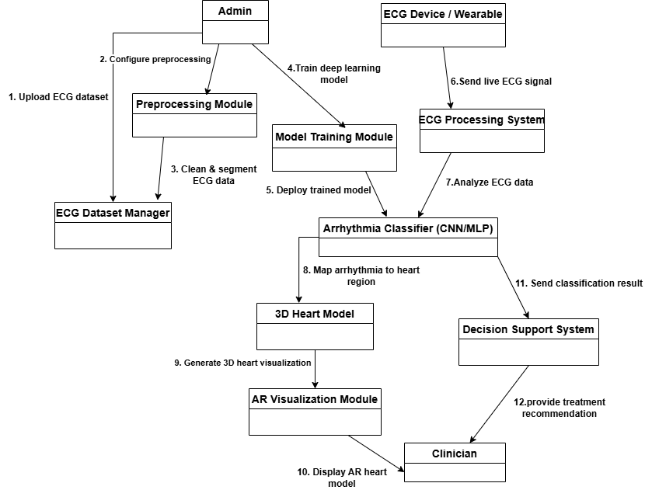
7. Collabration Diagram

Slide 19
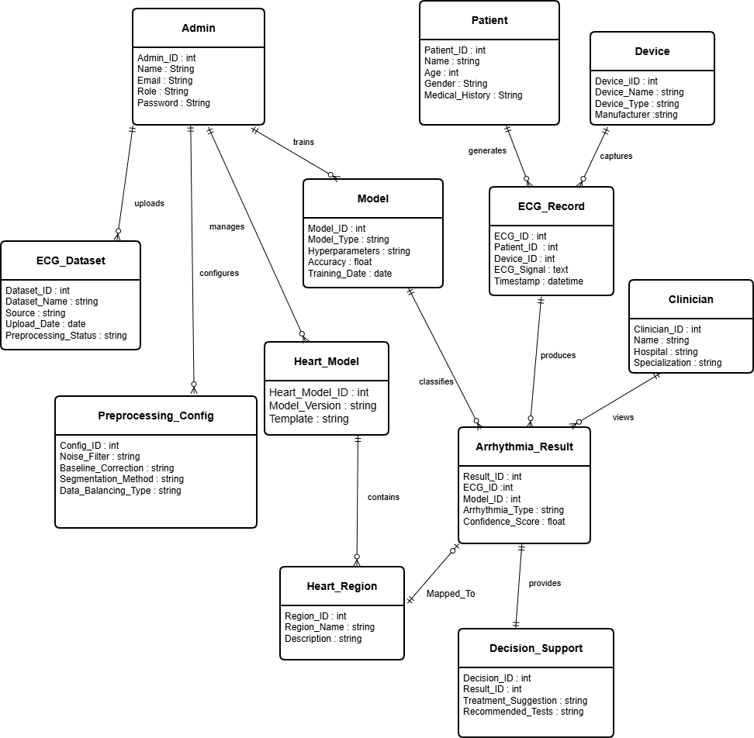
8. E-R Diagram

Slide 20
Conclusion
The ArythmiAR system represents a pivotal technological advancement in cardiovascular care. By successfully integrating Deep Learning (DL) for classification and Augmented Reality (AR) for visualization, this project addresses the critical need for timely and precise arrhythmia diagnosis.
It moves diagnosis beyond limited 2D displays, utilizing AR to enable real-time, interactive 3D localization of arrhythmia anomalies within specific heart sub-regions.

Slide 21
Thank you!

